Slide 1
Unit 1
UV AND IR SPECTROSCOPY

Slide 2
UNIT--I IR and UV spectroscopy
Which one of the following regions is known as a functional group region?
1300-1400cm~1
900-1300cm~1
650-900cm~1
None of the these
Which one of the following spectroscopy involves bombardment of a beam of high energy electrons in vacuum?
MS
UV
IR
NMR
What will be >c=o stretching band in IR of CH2=CH-C-CH3 compound?
1700cm~1
1710cm~1
1680cm~1
1780cm~1

Slide 3
Normal >C=C< stretching vibration frequency of alkenes ?
1675-1600cm~1
1850-1800cm~1
3650cm~1
1750cm~1 1
Which one of the following molecules is IR inactive?
Hcl
HBr
N2
ClBr
Number of fundamental vibrations in CO2 are ________
3
5
C. 4
6

Slide 4
The type of hydrogen bonding in organic compounds can be distinguished by taking the spectra after dilution with __________
A. water
B. methanol
C. carbon tetrachloride
D. acetone
Infrared spectra of which of the following isomers are the same?
cis/trans isomers
enantiomers
functional isomers
positional isomers
Correct increasing order of UV absorption maximum of the following compound is ______
Butadiene<Ethylene<Anthracene<Naphthalene
Butadiene<Naphthalene<Anthracene<Ethylene
Ethylene<Butadiene<Naphthalene<Anthracene
Anthracene<Naphthalene<Butadiene<Ethylene

Slide 5
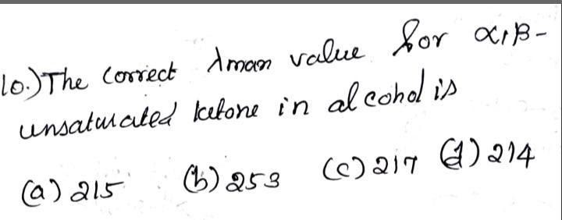
Fingerprint region from 1350-1000cm~1 does not include
. A. Primary alcohol
phenols
Esters
Nitro compound
Correct decreasing order of stretching frequencies of the following compounds is
C-H>N-H>O-H>F-H
F-H>O-H>N-H>F-H
C-H>O-H>N-H>F-H
F-H>O-H>C-H>N-H

Slide 6
.Correct decreasing order of IRfrequencies of >c = oof the following compounds.
A.cyclopropanone > cyclopentanone> cyclohexanone
cyclohexanone>cyclopentanone>cyclopropanone
cyclopropanone>cyclohexanone>cyclopentanone
None of the above
Far IR region covers the spectral range of
A.0.8 to 2.5 u
50 to 1000 u
2.5 to 50 u
D.above 1000 u
How many types of asymmetric stretching vibrations
A.2
B.3
4
5

